Slide 1
Artificial Neural Network

Slide 2
Some historical background
In early days, AI tackled and solved problems that are intellectually difficult for humans but easy to reason in mathematical formula (e.g. big math calculations)
The challenge is to build AI that can solve problems which are easy and intuitive for humans but hard to reason in terms of math (face recognition)
Knowledge based AI: hardcode knowledge about the world in formal language. Cyc engine discovered a cyborg in a story of “Fred shaving in the morning”
Learnt that AI needs to acquire their own knowledge by finding patterns in data - Machine learning
More Advanced AI: learn from experience using the hierarchy of concepts. Each concept is defined through relation to simpler concepts: Deep Learning

Slide 3
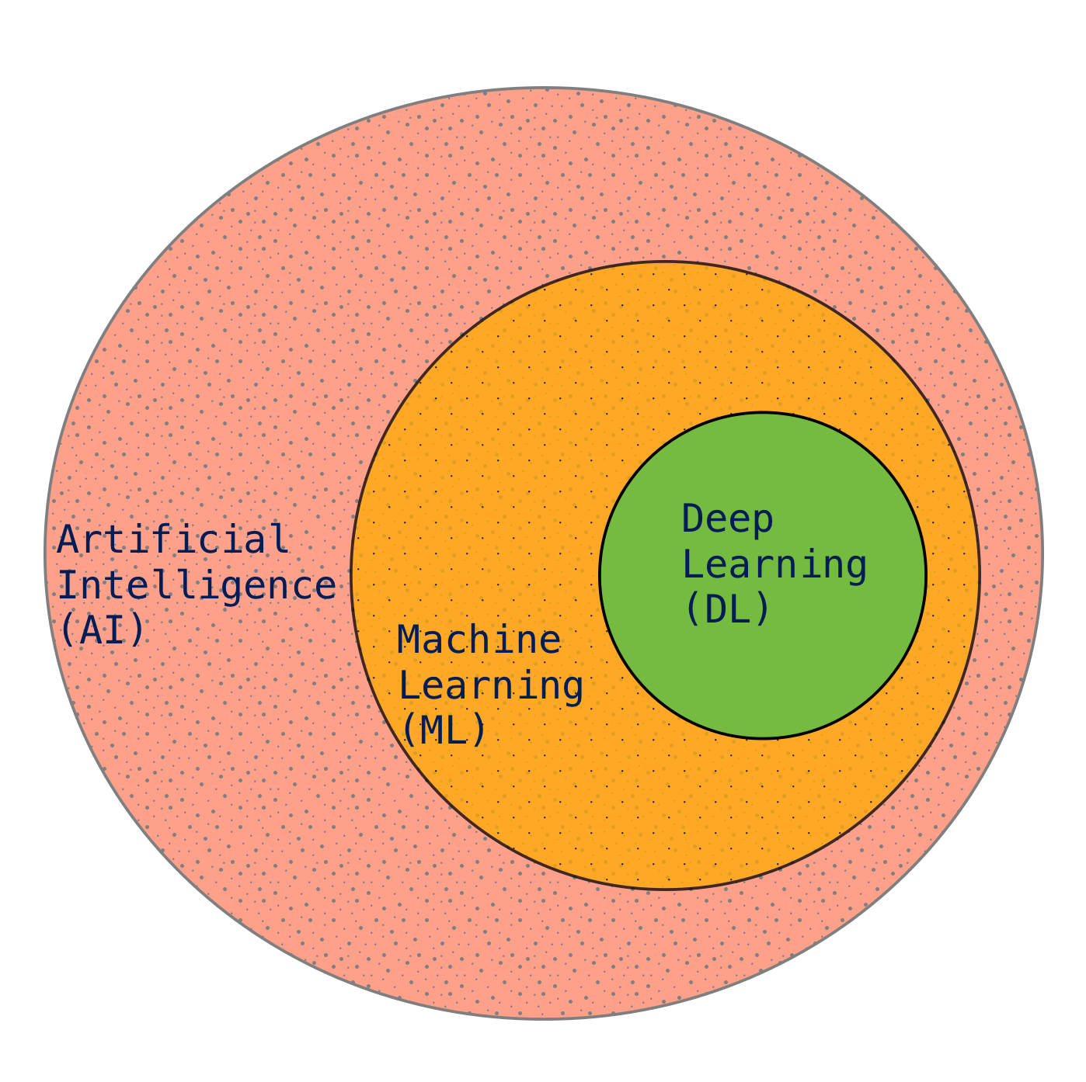
What is Artificial Neural Network?
Artificial Neural Network (NN) is a part of Deep Learning algorithms
Inspired by working principle of biological neurons in animal brains
First wave: 1940s-1960s, development of one single artificial neuron, perceptron
Second wave: 1980s-1995, development of backpropagation, multiple hidden layers
Third wave: 2006, started full scale ANN applications

Slide 4
What is Artificial Neural Network?
Reverse engineer the computational principles behind how brain works
Inspired by working principle of biological neurons in animal brains
Data driven statistical inference
Requires large volume data
Transforms input data to very high dimensional abstract space through complex model architecture

Slide 5
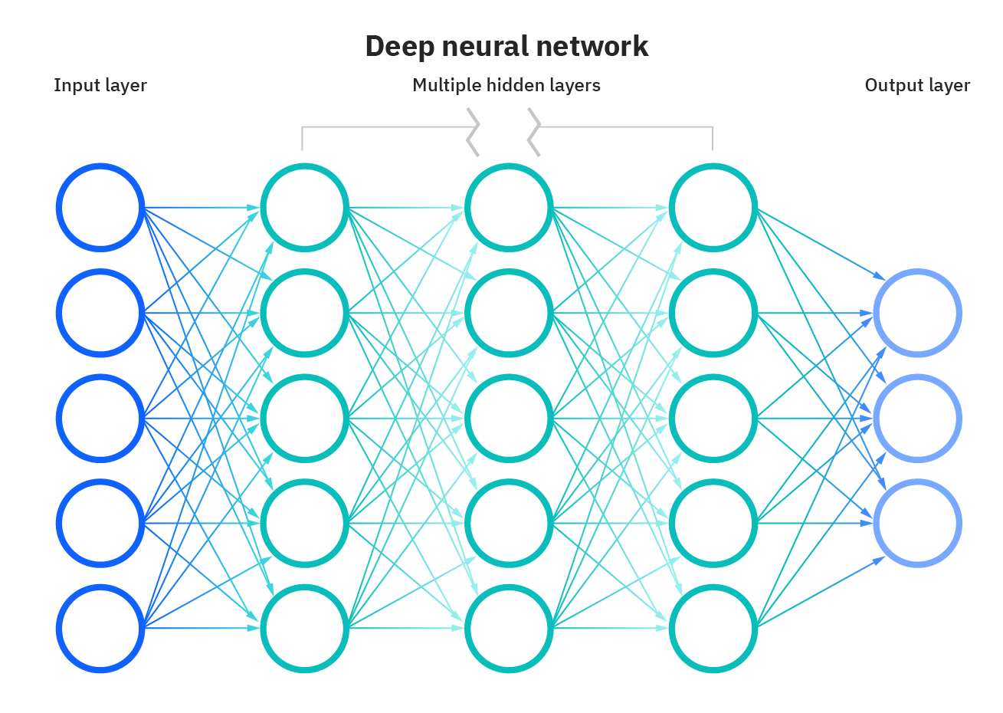
‘Vanilla’ Neural Network
Simplest form of ANN structure
Consists of input, hidden and output layer
Philosophy of “Neurons that fire together, wire together”
Relies on Stochastic Gradient Descent
Advancement of auto differentiation and computing power enables us to build such models
Image Credit: https://1.cms.s81c.com/sites/default/files/2021-01-06/ICLH_Diagram_Batch_01_03-DeepNeuralNetwork-WHITEBG.png

Slide 6
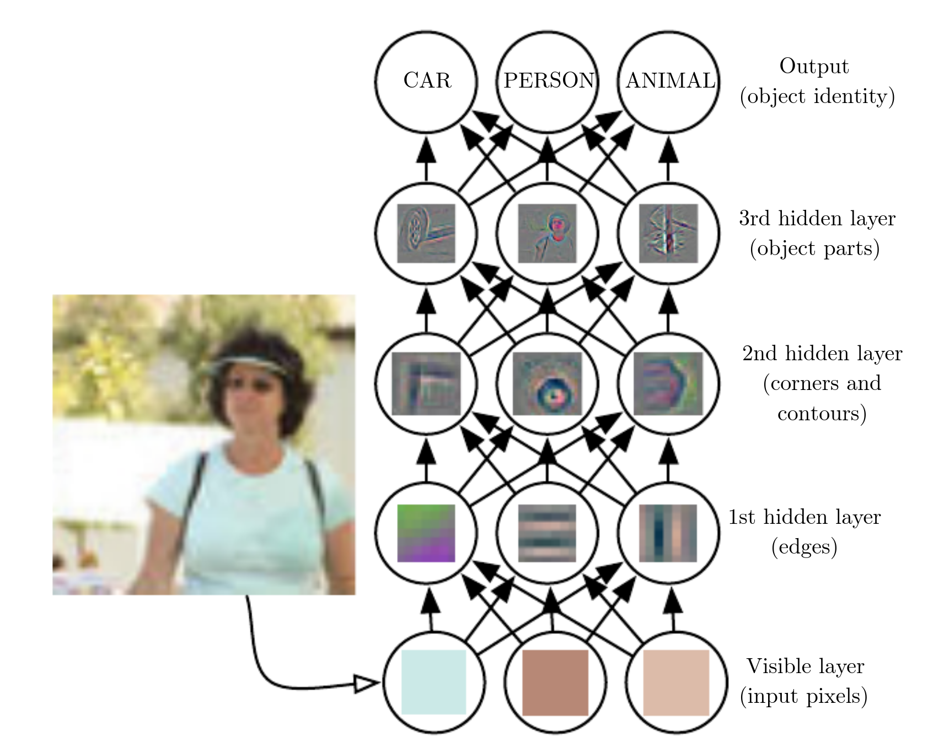
Building the hierarchy of concepts
Starts with pixel information
Builds simple local information in consecutive layers
Joins local concepts to build more complex information

Slide 7
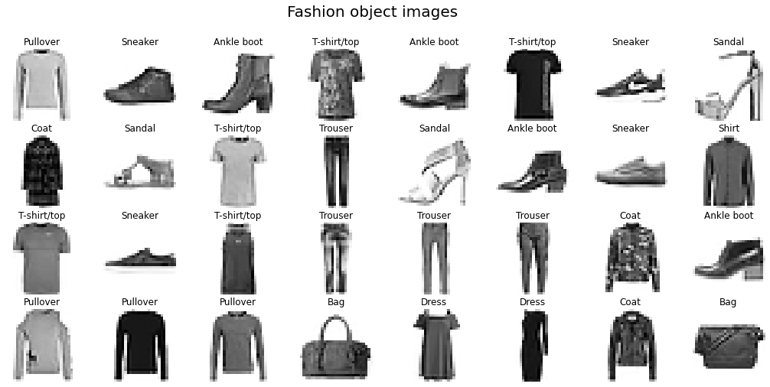
Fashion-MNIST data

Slide 8
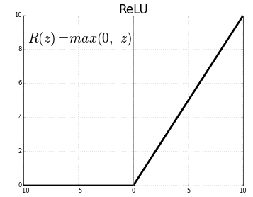
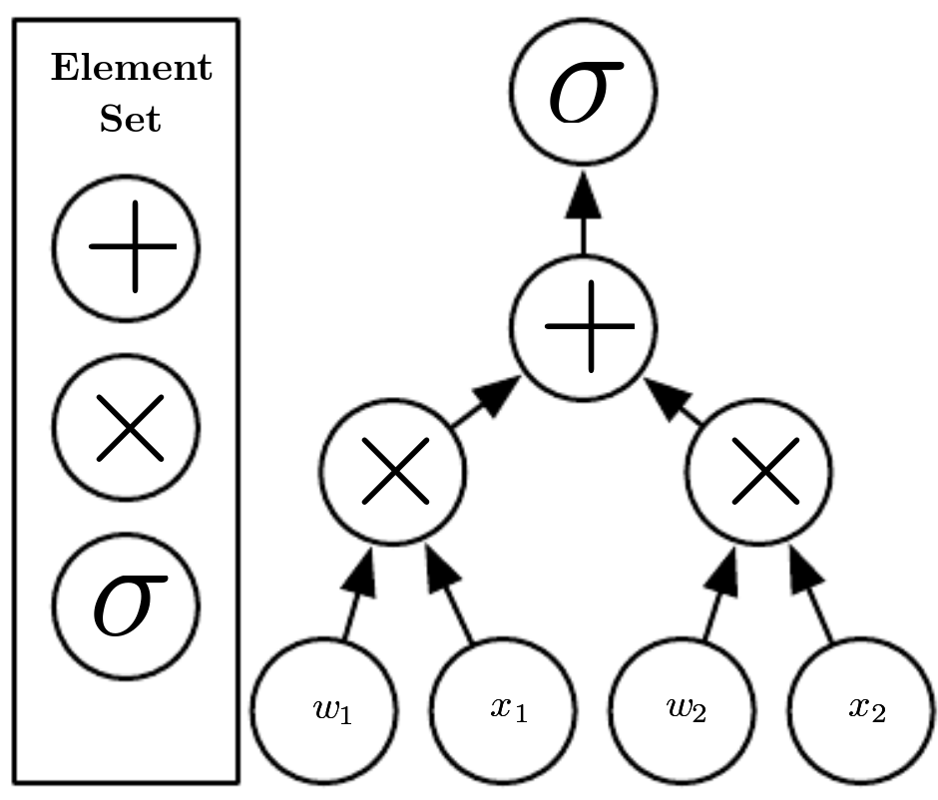
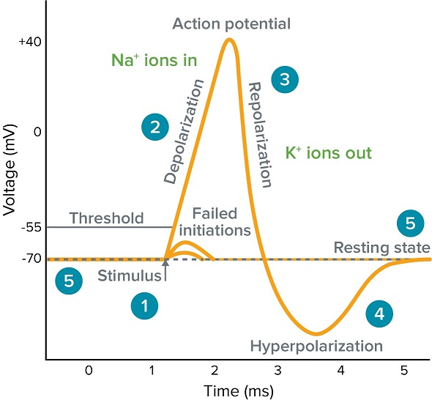
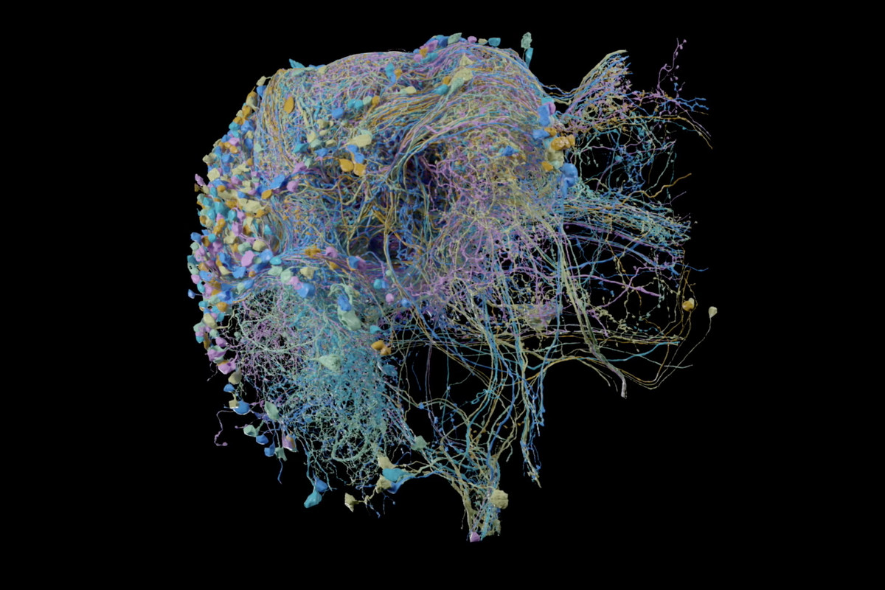
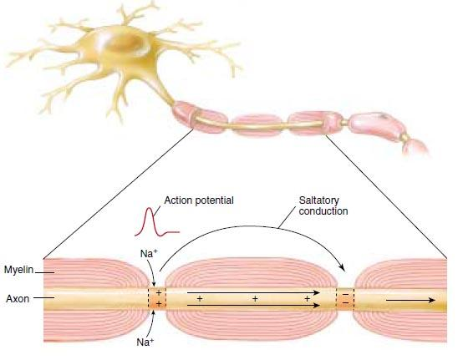
How to Build an ANN

Slide 9
How to Build an ANN

Slide 10
How to Build an ANN

Slide 11
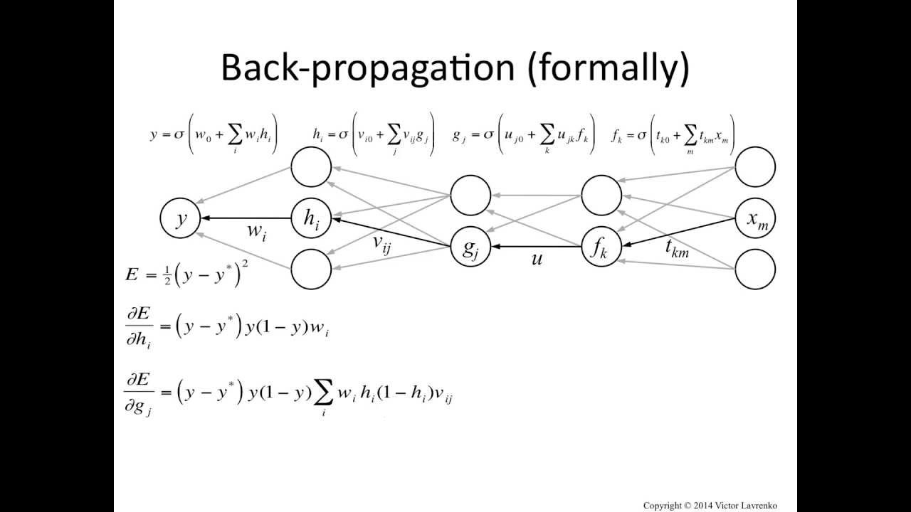
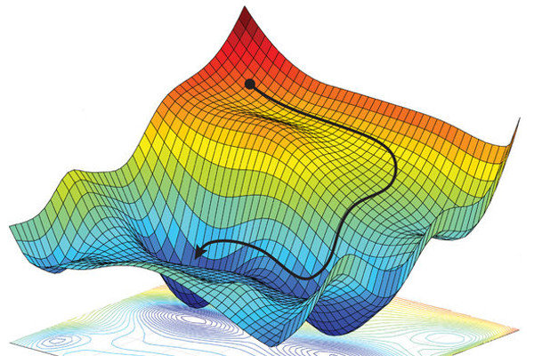
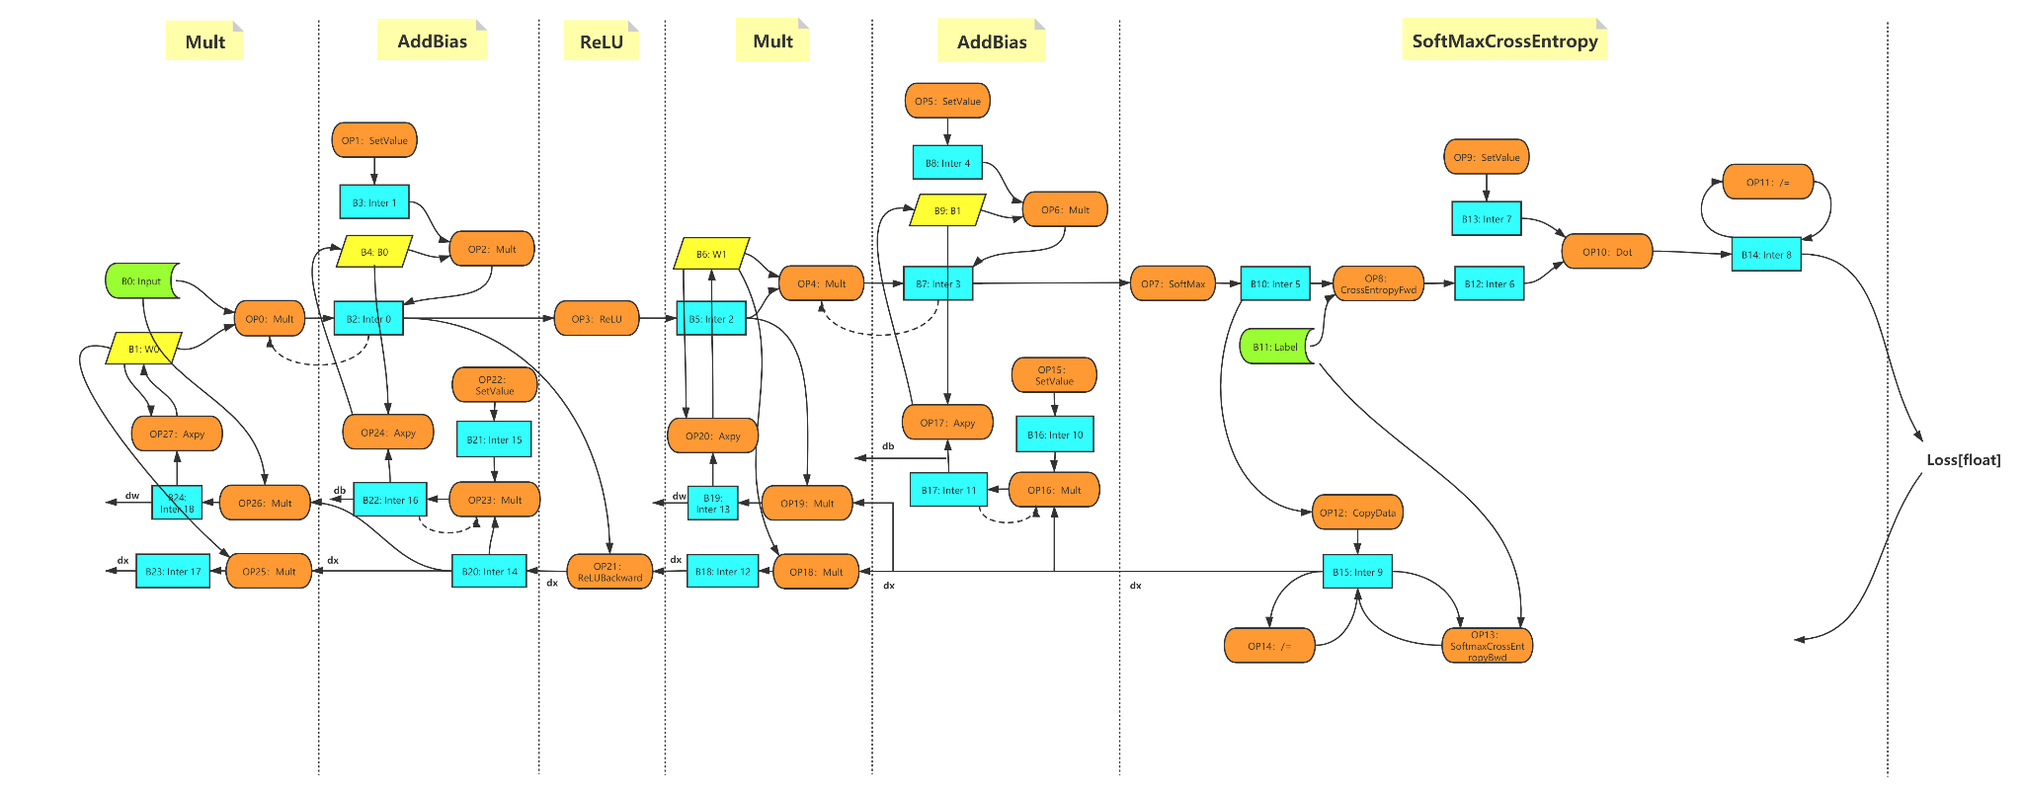
Stochastic Gradient Descent and backpropagation
Define Loss function that calculates the the error in predicting correct
In the “training” phase, we minimize the loss by tweaking the parameters
Tweaking of parameters happens through something called gradient descent
Backpropagation takes care of the gradients of all parameters
Autodifferentiation creates a computation graph to keep track of all the parameters

Slide 12



Introduction to PyTorch
Open source ML framework
Developed by Facebook and built upon Torch library
torch.tensor stores and processes multi-dimensional data in very efficient way
torch.autograd provides auto differentiation engine to perform stochastic gradient descent
APIs are intuitive, easy-to-use for ML project development

Slide 13
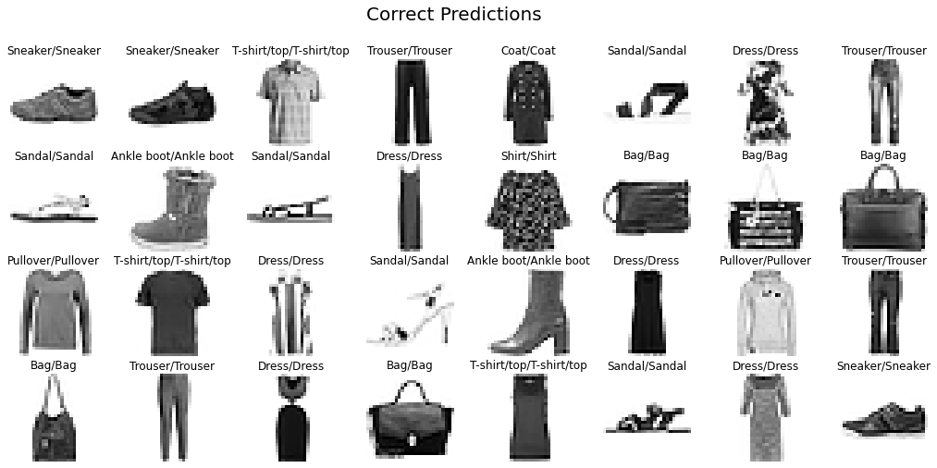
How does the model perform?

Slide 14
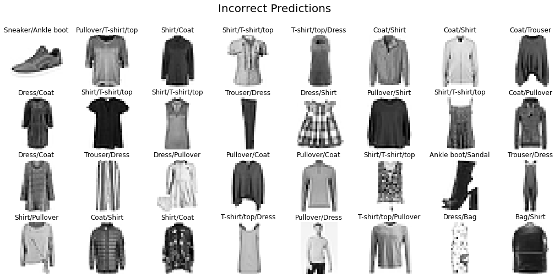
How does the model perform?

Slide 15
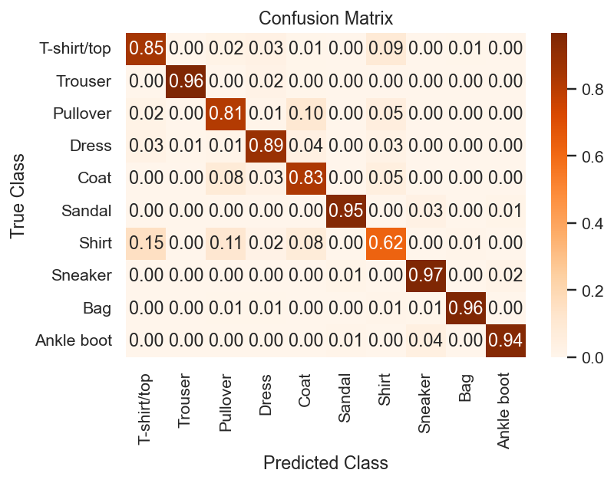
How does the model perform?

